Slide 1
Team A - Project Equifood
Jake, Amrita, Griffin, Abhiek

Slide 2
Introduction
The purpose of Equifood is to aid in reducing food wastage of restaurants. This app presents restaurant owners the idea of giving away excess food they have at the end of each day at discounted prices, or for free.
Equifood administrators manually keep track of the money amount Equifood has saved individuals from restaurants. These are considered as donations.

Slide 3
Our Software
Our software will allow restaurant owners to post their discounted/free offers for individuals to see and will automatically keep track of donation amounts.

Slide 4
Target User Groups
The administrators, the individuals in ownership of Equifood.
Their purpose in using the app will be monitoring that restaurant owners are using Equifood as per their guidelines. They will have the option to approve, deny, or remove restaurants from this app.
Admin will have access to viewing donation amounts.
The Restaurant Representatives.
The app will allow them to post information about their restaurant and food options available.
They will update total donations collected from their restaurant.
Individuals.
Will be able to use the app to view available restaurants and food options.

Slide 5
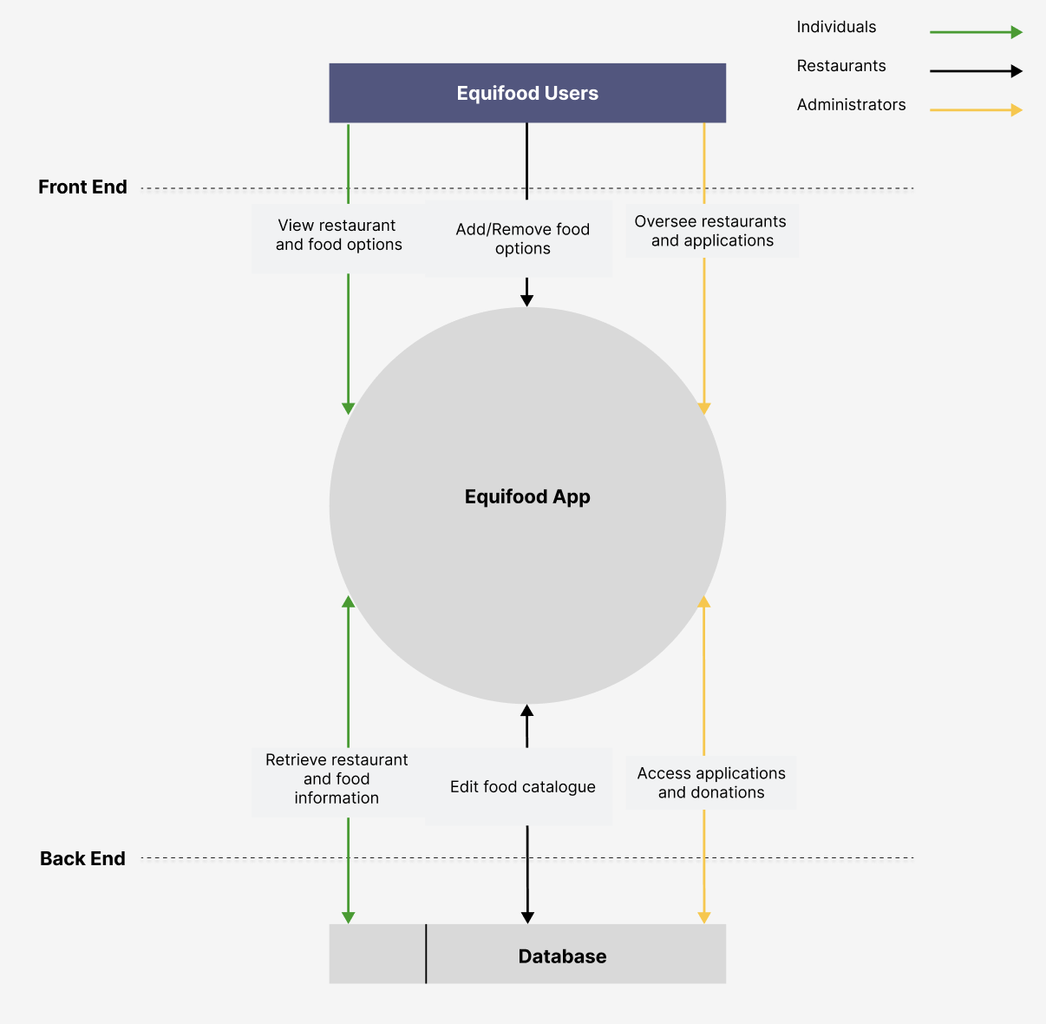
Level 0 Data Flow Diagram
Individuals see the food options
Restaurants control the food options they display
Administrators control which restaurants are on the app

Slide 6
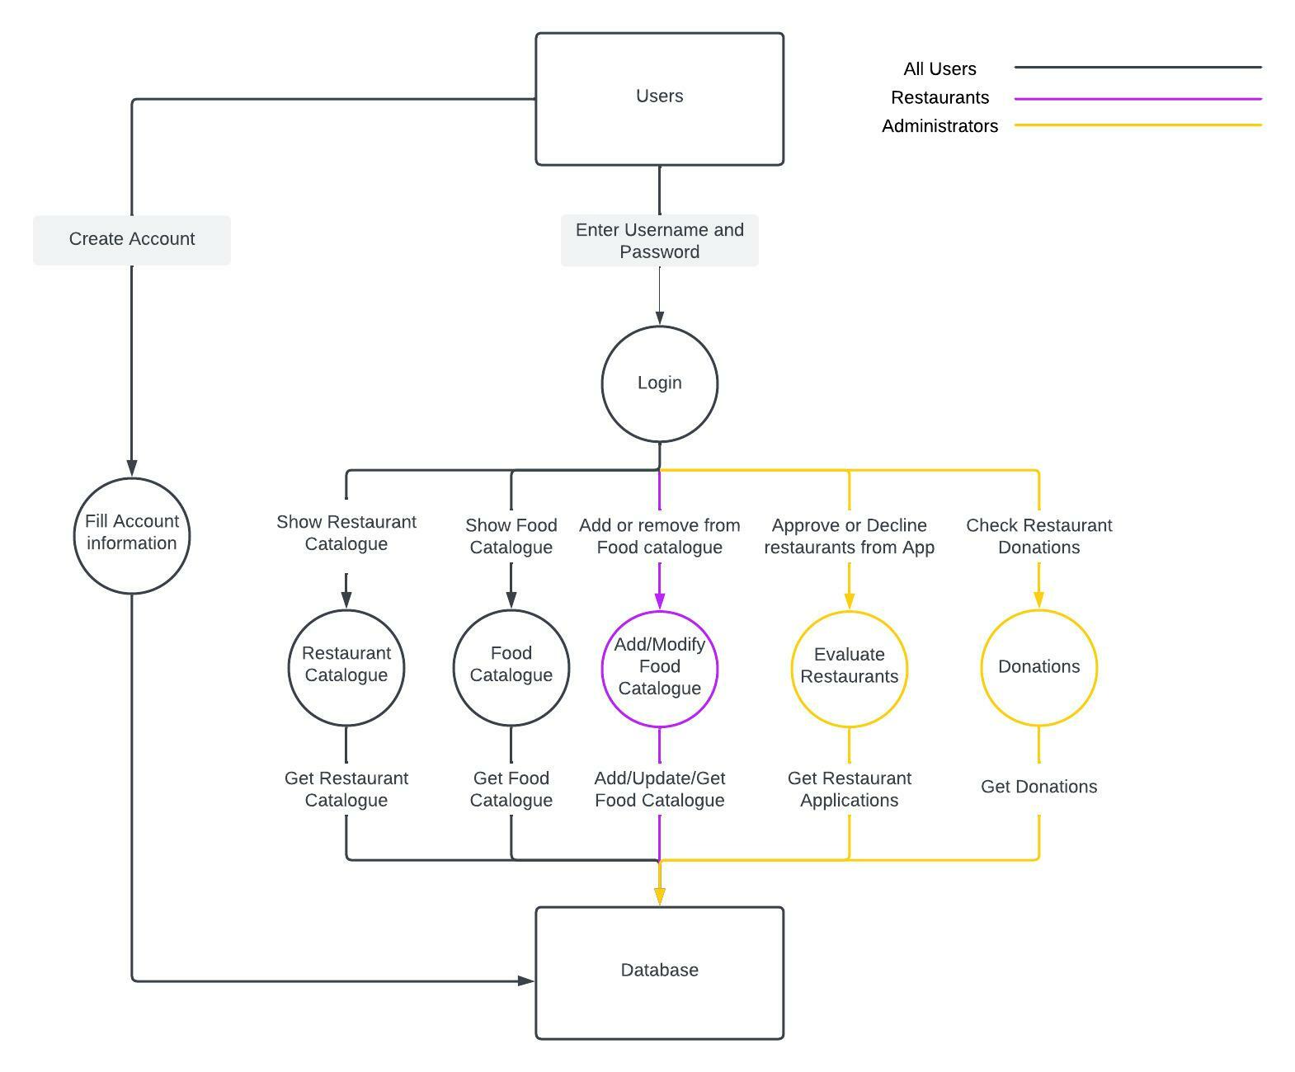
Level 1 DFD
Individuals will want to see the restaurant and food catalogues - Milestone 1 will have a basic front end
Restaurants add/modify food catalogue - Milestone 3
Administrators

Slide 7
Functional Requirements
Milestone 1: Basic Front End
Allow users to see restaurant and food options
Milestone 2: Create Databases, implement backend, improve navigation
Clicking things bring you to the proper pages and show proper values
Milestone 3: Deploy and populate databases
Milestone 4: Extensively test, document, and prepare for handoff

Slide 8
Non-functional Requirements
Communication with the client.
Team members level of familiarity with the coding languages and development environments chosen.
Team members personal laptop restrictions to software or memory we may require for development.
The reliability of software will be determined by running it many times with the expectation of accurate results 90% of the time.
Test performance to have response time of 1 second.
The adaptability of software by organizing code with comments further clarity.
Detailed documentation for potential further development of the software.

Slide 9
Tech Stack Option 1
Technology | Product | Cost
Frontend | React and node | Free
Backend | Express | Free
Database | MongoDB | Free ($15 a month if more storage is needed.)
Apple imposes a $135 cost to upload an app to the app store, this must be renewed yearly
Android imposes a one time $35 dollar cost to upload an app to then play store, this does not need to be renewed
*all prices are in canadian dollars
Total estimated cost of option 1: $35 + $15 monthly + $135 yearly
*$35 for android development cost, $15 a month for data storage and $99 yearly for apple development cost

Slide 10
Tech Stack Option 2
Technology | Product | Cost
Frontend | Flutter | Free
Backend | Firebase | Free (Hosting and storage capacities can be scaled massively for approximately $5 a month)
Database | Firebase | Free (same scaling cost as above)
Design | FlutterFlow | $595 for two months of team access
Apple imposes a $135 cost to upload an app to the app store, this must be renewed yearly
Android imposes a one time $35 dollar cost to upload an app to then play store, this does not need to be renewed
*all prices are in canadian dollars
Total estimated cost for option 2: $595 + $5 a month + $135 yearly
*The $595 comes from two months of FlutterFlow subscriptions for the team. This can be cut to $35 without the inclusion of Flutter flow.

Slide 11
Web Application Tech Stack
Technology | Product | Cost
Frontend | React + Javascript | Free
Backend | Express + Node.js | Free
Database | MongoDB | Free ($15 a month if more storage is needed)
A Web application would greatly reduce initial and recurring costs.
This idea is still under review with the client.
Total Estimated cost: $15 Monthly

Slide 12

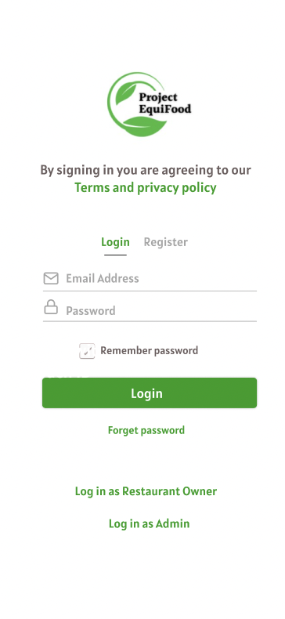
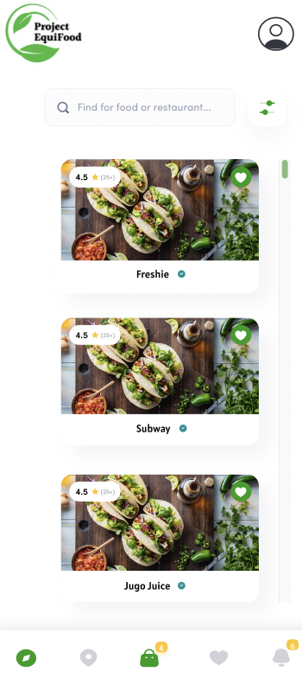
Prototype
*The initial loading screen for the app
*The login screen.
At the bottom there is two options to log in as a restaurant owner or and admin
*The main browsing screen. A block style scroll with a search bar. Options at the bottom are as follows: main screen, location selection, Cart, Favourites and, Notifications .

Slide 13
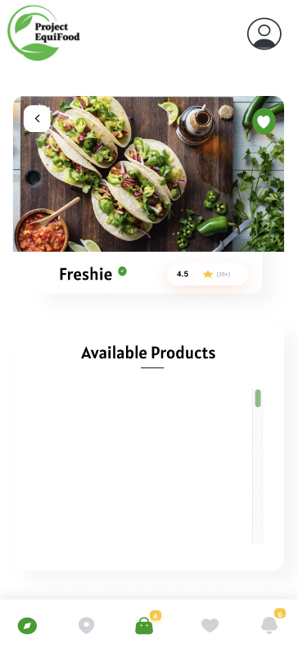
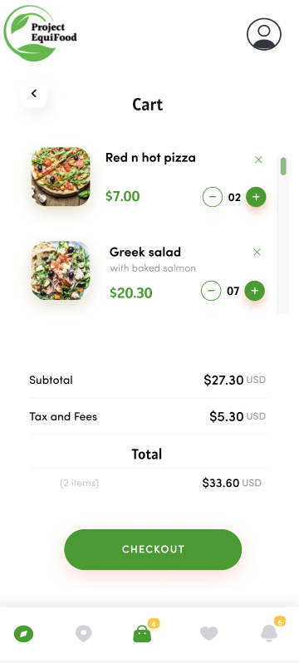
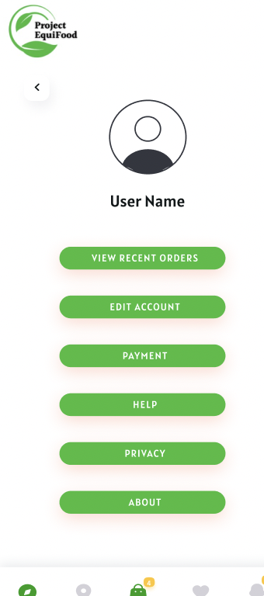
Prototype Contd.
*After selecting an establishment, this screen displays their available products
*This screen displays the users cart and selected items with confirmation to reserve them for pickup. (all payment is done at the establishments)
*The user profile page allows payment methods to be added, account changes, recent orders and more

Slide 14


General Testing Strategies
We will be using emulators to test the UI, functionality and performance.
Unit Testing with Jest.
API endpoint unit and stress tests using Postman.
Source
Source
Notes:
We will be using emulators like android studio to test the UI, functionality and performance.
To ensure that the application works - we will be testing various inputs for
expected outputs, and verifying the system does what it should using jest unit tests.
Once all functional requirements have been met for a milestone, we will adopt a non-functional testing approach to verify that the application performs well. We will also be conducting tests using Postman to unit and load test our API Endpoints.
a UX review and a technical review will be required before every merge to master

Slide 15
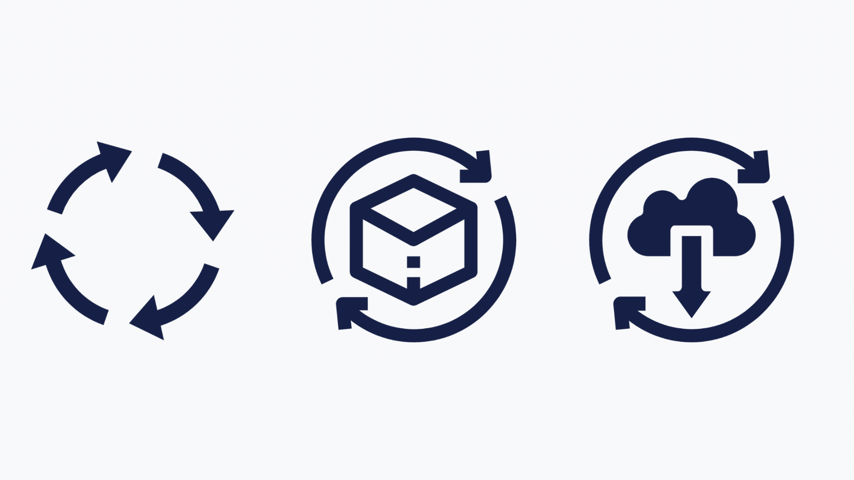
CI/CD
GitHub Actions to setup a CI/CD pipeline to ensure fast development and deployment.
Source
Notes:
To ensure continuous integration and deployment throughout the development cycle, we will be using github actions to setup a CI/CD pipeline. We will also be setting a staging and a production server. We will first merge our code changes to staging to ensure that our app doesn’t break, if successfull, the code will be shipped to production.

Slide 16
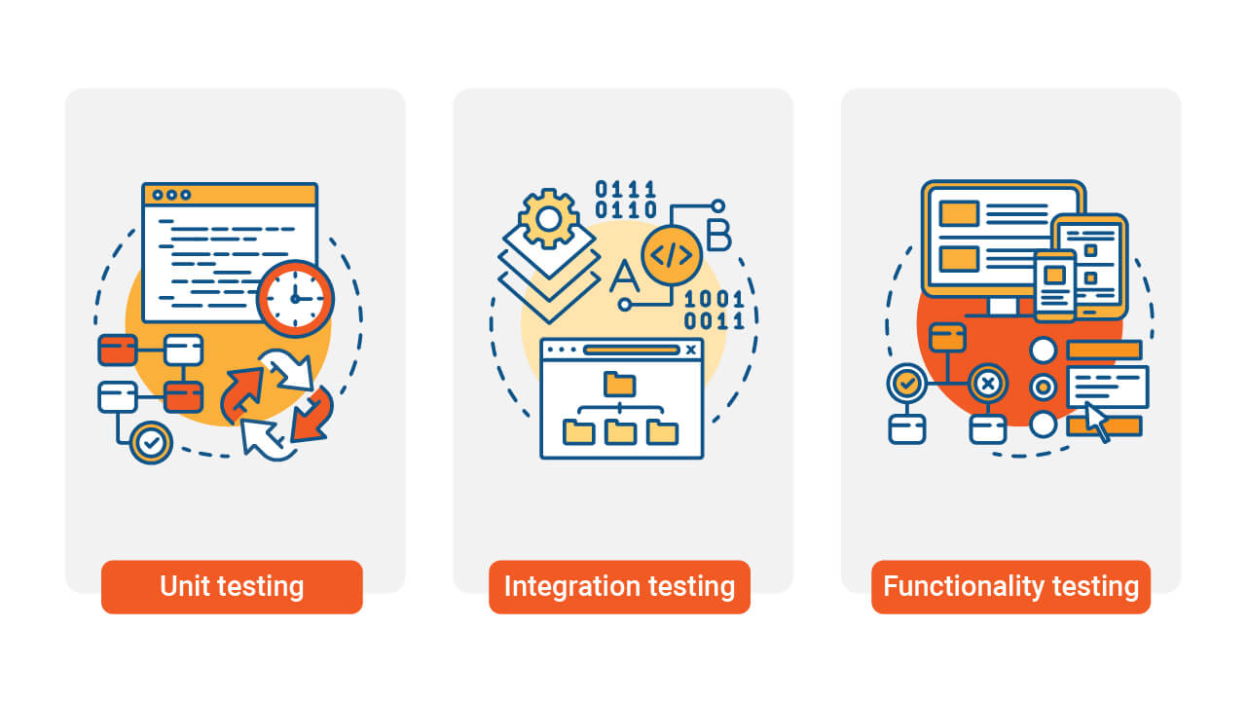
Integration Testing
To make sure integrated components work correctly to provide the correct functionality.
Source
Notes:
We will know, from our functional requirements, what the expected output for every input is , therefore we will be writing tests while treating our system as a black box and ensure that all the individual components of our App are integrated properly.

Slide 17
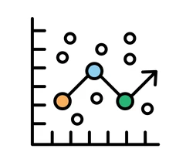
Regression Testing
Pre-commit hooks + Automated testing in the CI/CD pipeline.
Source
Notes:
We will setup pre-commit hooks to ensure that all tests pass and the app builds before commits are staged , we will also add automated testing to our CI/CD pipeline on every merge to master.
This will make sure that all our test cases pass before our changes are merged into production/staging and minimize the chance of breaking the app

